Slide 1
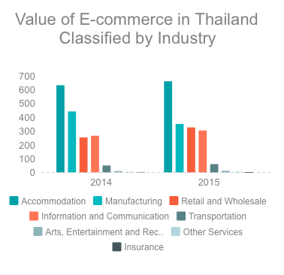
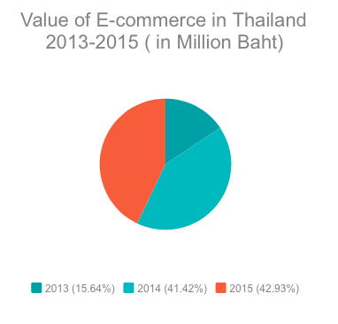
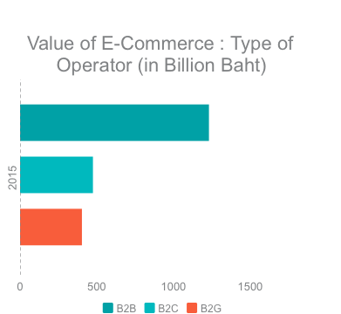
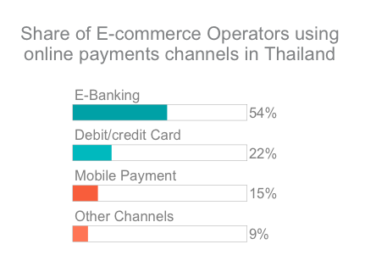
DIGITAL PAYMENT MARKET IN THAILAND
Market
1.The digital payment economy in SEA is expected to reach $200 billion by 2025.
The top 3 industries with the highest value of E-Commerce were;
accommodation industry of 658,909.76 million baht (38.43%).
manufacturing industry of 350,286.83 million baht (20.43%)
the retail and wholesale industry of 325,077.48 million baht (18.96%).
E-Commerce value in Thailand for the year 2015 is 2,107,692.88 million baht.
Growth rate increase from 2014 was 3.65%
.
1.Funding capital
2.Payment mechanisms
3.Internet Infrastructure.
4.Lack of consumer trust
Trends
In 2015, E-Commerce value was 58.37% of the total value of E-Commerce.
The value of B2C E-Commerce was second highest at (22.52%).
The growth rate of the values of B2B, B2C and B2G commerce was-0.33%, 15.29% and 3.96%, respectively.
The most popular online payment service is e-banking (54.25%), which is a payment method made via Internet banking, mobile banking and ATMs.
1.Thriving young population
2.Increase internet speed.
3.GDP growth
4.Lack of store access
5.Condusive payment ecosystem.
Drivers and Challenges
260 M
Internet users in SEA
3.8 M
Internet users every month
700 M
Mobile Connections

Slide 2
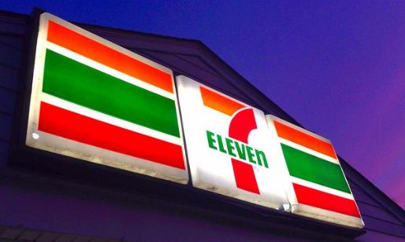
AREA OF OPPORTUNITY FOR DIGITAL PAYMENT MARKETS IN THAILAND
CURRENT CHALLENGE
60-70 % of citizens are “unbanked” leading to consumers to wary of transacting online.
58 % of citizens in SEA have expressed concerns over financial information being shared online.
Lack the infrastructure that supports the online commerce craze such as a strong logistics network and stable Internet connection, mainly in rural areas
CURRENT OPPORTUNITY
With Amazon reportedly eyeing the region for their next expansion plan, analysts predict that the number of online and online retails tie-ups is only going to grow in the future.
Minimarket chains can step in to help as they typically operates many 24 hour- stores in close proximity to most shoppers’ homes, analysts said.
7–11 is the largest convenience chain in Thailand with over 9,000 stores .
THUS THE CURRENT AREA OF OPPORTUNITY FOR E-COMMERCE IS TO WORK WITH CONVENIENCE STORES.
Capture growth beyond the tech-savvy online users
Overcome consumer’s fear of leakage of financial information
Potential synergy between two of the largest sectors i.e. tech and retail
Trend likely to continue in future. With consumers increasingly living ‘on-the go’ lifestyles and rising traffic congestion in many cities.
The number of minimarket and convenience stores in the region is predicted to grow more than 10% annually from over 225,000 stores currently indicating a huge scope for increased sales and profit.
POTENTIAL BENEFITS
LIMITATIONS
Technology remains the biggest barrier as countries like Thailand and Indonesia still need to strengthen their infrastructure to support the booming digital economy.
Educate and inform people about the changes in the digital economy and convince them to move beyond their traditional methods.

